Slide 1
The GPAA RFP to implement Enterprise Data Management
GPAA15/2015

Slide 2
Discussion Points
Introduction
Components of Enterprise Data Management
As-Is
To-Be
Functional Requirements
Data Migration and Integration
Master Data Management
Enterprise Data Model
Data Quality Monitoring
Architectural Requirements

Slide 3
Introduction
GPAA has embarked on a programme that seeks to modernise and enhance the efficiencies of human capital, systems, processes and technology.
Data quality and management in the organisation is central to the programme becoming a success.
Objective is to establish and operationalise the management of information during the entire life cycle.

Slide 4
Components of Enterprise Data Management
Required to sustain,adapt,adopt,embed and operationalise data quality management
Data
Quality
Data Migration & Integration
Master Data Management
Business Intelligence
Enterprise Data Model
Common Entities
Single View
Cleansing
Monitoring
Transformation
Distribution
Central Repository
Common Taxonomy
Key Performance Indicators

Slide 5
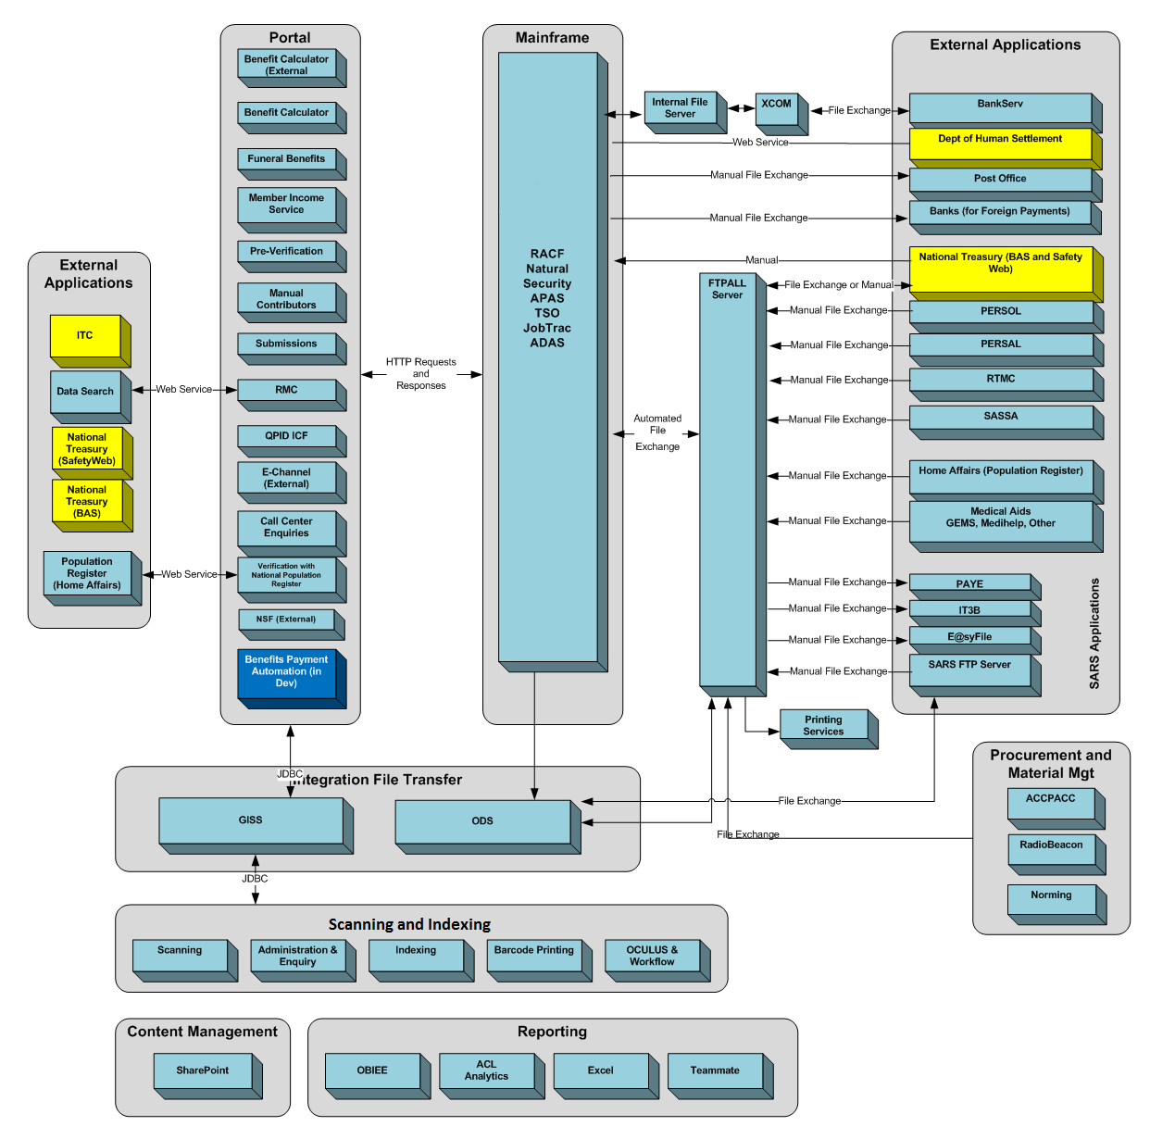
As-Is Information Flow

Slide 6
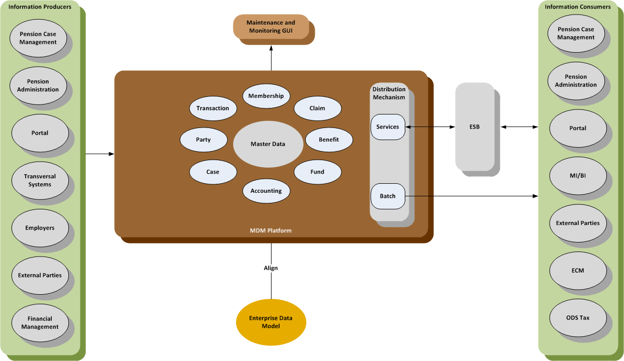
To-Be EDM

Slide 7
Data Migration & Integration
Data analysis and profiling
Data classification
Data cleansing and transformation
Data audits, analysis and reconciliation reports
Migration strategy and approach
Internal and external sources

Slide 8
Master Data Management
Manage multiple business entities
Support best practise data governance policies
Integrate to the GPAA security and reporting tools
Provide a workflow capability
Automatic data services updates based on data model changes
Able to create a golden record for any data entity with unmerge functionality
Record history of all changes to data
Reference data within a central repository
Capabilities and functions as services or routines
Membership Management
Pensioner Maintenance
Contribution Management
Benefits Processing
Tax Directives
Accounting Maps
Financial Management

Slide 9
Enterprise Data Model
Common data objects or entities and their key attributes
Business and technical terminology
Metadata function to manage the technical, operational, and business metadata
Technical metadata should include legacy platform fields and definitions
Operational metadata should include data transfers, movement, and mapping
Business metadata encompasses business glossary and the common vocabulary.

Slide 10
Data Quality Monitoring
Monitor data quality metrics which is linked to key organizational and individual performance indicators
Reports and dashboards that reflect the data quality metrics and known data issues
Consolidated financial information to a single repository for accurate and timely financial reporting

Slide 11
Architectural Requirements
Architecture Style
Solution should provide the required functionality out-of-the-box
Implementation
Data cleansing, migration and configuration part of implementation
Qualities
Interoperability, scalability and maintainability
Operational
Support full redundancy and expose sufficient and useful instrumentation to perform system monitoring, debugging and performance tuning
Handle increases in load without impact on the performance of the system, and provide the ability to be readily enlarged

Slide 12
Architectural Requirements cont.
Authentication and Authorisation
Integrate into the Oracle Identity and Access Management system for all identity management and role-based access functionality
Ensure Role-based Access Management is applied using single sign on (SSO)
Integration
Applications, as providers should be decoupled from consumers based on SOA principles to promote the introduction of new applications
Real-time / messaging integration should be completed using the ESB
Data Architecture
Provide batch and online data distribution mechanisms
Historic information should be available for extraction into other tools for trending and forecasting
Information should remain confidential when required due to either member preference or legislation. Information classification should be enabled within the architecture to control user access.

Slide 13
Thank You

